Slide 1
SHOPKART TEST AUTOMATION
Cucumber BDD Framework Walkthrough
UI · API · Database · Security — one framework, four layers
Week 6 – Gate 6 Assessment

Slide 2
THE BIG IDEA
One user journey, tested from four angles
A real shopping flow — search, cart, checkout — touches a browser, a REST API, and a database. Testing only the UI misses backend bugs; testing only the API misses what the customer sees. This framework hits every layer on purpose.
🖥
🔌
🗄
🔒
UI
API
Database
Security
Selenide + Page Objects
REST Assured clients
JDBC repositories
Negative/auth checks

Slide 3
ARCHITECTURE
How a scenario flows through the framework
Feature files (Gherkin)
Plain-English scenarios, tagged @smoke @api @db @ui @e2e @negative @security
↓
Step definitions
Java classes mapping each Gherkin line to real code
↓
API clients → UI page objects
AuthClient / CartClient / OrderClient / ProductClient — LoginPage / HomePage / CartPage
↓
Database repositories
CartRepository / OrderRepository run JDBC queries to verify persistence
↓
WorldContext
Shared state (token, cartId, orderId) passed across steps in one scenario

Slide 4
LAYER 1
Feature files: the scenario in plain English
@api @negative
Feature: Cancel rules
Scenario: Cancel a placed order only once
Given Alice has placed an order
When Alice cancels the order
Then the order status should become "CANCELLED"
When Alice cancels the same order again
Then the response status should be 409
Given / When / Then
Maps 1:1 to a step definition method
Tags (@api, @db…)
Let Gradle run just one slice: ./gradlew api
One scenario, one flow
Reads like a QA test case a non-coder can review

Slide 5
LAYER 2
Step definitions glue Gherkin to code
Each step definition class is thin on purpose — it just calls an API client or a page object, then asserts. State that needs to travel between steps (login token, cart id, order id) lives in one shared object: WorldContext.
CancelOrderSteps.java
WorldContext — shared per scenario
@When("Alice cancels the order")
public void cancelOrder() {
orderClient.cancelOrder(
context.getToken(),
context.getOrderId());
}
• token
• customerId
• cartId
• orderId
• responseStatus
• loginPage / homePage / cartPage / checkoutPage / orderPage

Slide 6
LAYER 3
API layer: REST Assured clients
Every REST call the app supports is wrapped once, in one place. Step definitions call these clients instead of writing raw HTTP requests, so a scenario stays readable and a change to an endpoint is fixed in a single file.
AuthClient
ProductClient
CartClient
OrderClient
login() → token + customer
search(keyword) → products
createCart, addItem, getCart
placeOrder, getOrder, cancelOrder
POST /auth/login
GET /products?q=
POST /carts/{id}/items
POST /orders/{id}/cancel

Slide 7
LAYERS 4 & 5
UI: Page Object Model — DB: verify what the API claims
🖥 Selenide Page Objects
🗄 JDBC Repositories
• LoginPage, HomePage, CartPage, CheckoutPage, OrderPage
• CartRepository.cartTotal(cartId) runs SQL directly against MySQL
• Each page hides its own locators — step defs never touch a By.id() directly
• OrderRepository.orderStatus(orderId) checks the row actually changed
• homePage.searchProduct("lamp") reads like the Gherkin step it implements
• Proves the API isn't lying — the database, not just the response, agrees
• Hooks.java sets browser/timeout config before each scenario, closes the driver after
• Used in cart-totals and cancel-rules scenarios

Slide 8
SUPPORTING PIECES
Config, secrets, and Allure reporting
Env / Secrets / AppConfig
environment.properties
categories.json (Allure)
Reads env vars, system properties, then .env — in that order. No hardcoded URLs or passwords in test code.
Records app, browser, base URL, and DB used for a run — shown at the top of the Allure report.
Buckets failures: assertion, UI, database, config, infrastructure — so a failed run points you at the right layer instantly.

Slide 9
TEST SCOPE
The six scenarios — one per Week-6 skill
# | Feature | Proves | Layers | Tags
1 | Product search | Search returns matching products | UI + API | @smoke @ui @api
2 | Cart totals | Total = Σ(qty × price), in paise | API + DB | @api @db
3 | Checkout E2E | Login → search → add → cart → checkout → PLACED | UI→API→DB | @e2e @smoke
4 | Order access | Owner 200; another customer 403 | API | @api @negative @security
5 | Cancel rules | Cancel PLACED→CANCELLED; again→409 | API | @api @negative
6 | Out of stock | Add qty > stock → 409 | API | @api @negative

Slide 10
RUNNING IT
Gradle tags decide what runs
build.gradle.kts registers one Test task per tag. Each filters Cucumber by @tag, so you can run a fast smoke pass or a full nightly run of everything.
./gradlew smoke
Fast confidence check — @smoke only
./gradlew api
All API-layer scenarios — @api
./gradlew ui
Browser-driven scenarios — @ui
./gradlew db
Database verification scenarios — @db
./gradlew negative
Failure-path scenarios — @negative
./gradlew security
Auth/access-control scenarios — @security
./gradlew e2e
Full user journey — @e2e
./gradlew test
Everything, all tags

Slide 11
TAKEAWAYS
Why this design matters
Layered, not stacked everything on UI
UI tests are slow and flaky — push logic checks down to API/DB where they're fast and stable.
Gherkin is documentation
Anyone — not just developers — can read what's being verified.
One shared context per scenario
WorldContext avoids static/global state while still passing data between steps.
Tags = selective execution
One codebase, many run profiles: smoke, full regression, security-only, etc.

Slide 12
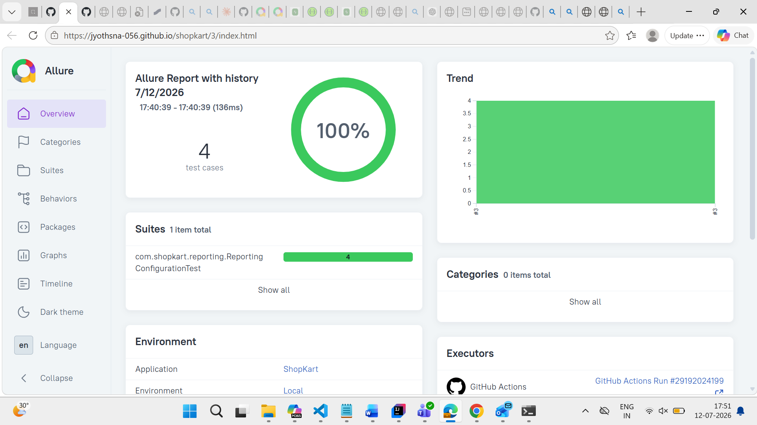

Slide 13
Jyothsna-056/shopkart: Github link.
THANK YOU

